Slide 1
COST OF CAPITAL
Cost of Equity • Cost of Debt • Weighted Average Cost of Capital

Slide 2
Learning Outcomes
By the end of this session, students will be able to:
UNDERSTAND
Explain the concept of cost of capital and describe the components of cost of equity and cost of debt
2
Bloom's Level 2
APPLY
Calculate cost of equity (CAPM / DGM) and after-tax cost of debt; compute WACC using appropriate weights
3
Bloom's Level 3
ANALYZE
Analyze how capital structure changes affect WACC and evaluate their impact on investment decisions
4
Bloom's Level 4
2

Slide 3
Features of Equity Shares
1
2
3
Residual Claim
Voting Rights
Dividends
Paid last, after debt & preference holders, but owns residual profits/assets
Typically one share = one vote on major corporate decisions
Not fixed or guaranteed — paid at the board's discretion
4
5
6
Perpetual Capital
Limited Liability
Capital Appreciation
No maturity date; stays on the balance sheet indefinitely
Losses capped at the amount invested
Returns mainly via share price growth, not fixed interest
3

Slide 4
Ordinary Shares vs. Dual-Class Structures
ORDINARY SHARES
DUAL / MULTI-CLASS SHARES
One share = one vote (proportional control)
Voting power matches economic investment
Standard structure for most listed companies
No separate classes with unequal rights
Same economic (dividend) rights, different voting rights
Founders hold high-vote shares to retain control
Public investors typically get low/no-vote shares
Used by Alphabet, Meta & other tech firms to raise capital without losing control
4

Slide 5
Case Study: Alphabet's Three-Class Structure
Class A (GOOGL): 1 vote/share, publicly traded
Class B: 10 votes/share, held only by founders, never publicly traded
Class C (GOOG): No votes, publicly traded
Founders Larry Page & Sergey Brin hold ~52.7% of voting power with under 12% of the economic stake
5

Slide 6
Case Study: Meta's Two-Class Structure
Class A (META): 1 vote/share, publicly traded
Class B: 10 votes/share, held almost entirely by Mark Zuckerberg
Zuckerberg holds 99.7% of outstanding Class B stock
This gives him ~61% of total voting power with only ~13-14% of the economic interest
6

Slide 7
Founder Control: Voting Power vs. Economic Stake
A small economic stake can translate into majority control — the classic separation of ownership and control.
7

Slide 8
Systematic Risk
Market Risk • Non-Diversifiable Risk
Affects the entire market/economy — arises from macroeconomic, political or social forces no single company controls. Cannot be diversified away.
Interest Rate Hikes
Inflation
Recession (2008 Crisis)
Pandemic (COVID-19)
Costlier borrowing depresses valuations market-wide
Erodes purchasing power & margins across sectors
Crashed markets worldwide — banks, retailers, tech alike
Disrupted supply, demand & labor across every industry
8

Slide 9
Unsystematic Risk
Specific Risk • Diversifiable Risk
Affects a particular company or industry only — can be reduced or eliminated by holding a diversified portfolio.
Management Decisions
Labor Strikes
Product Recall
Fraud / Scandal
A failed acquisition hurts only that firm's stock
Halts one manufacturer's plant, not the whole industry
A defective-drug recall hits one pharma company, not the sector
An accounting scandal tanks that specific stock
9

Slide 10
Systematic vs. Unsystematic Risk
Basis | Systematic Risk | Unsystematic Risk
Scope | Entire market / economy | Specific company / industry
Source | Macroeconomic, political, social | Firm-specific (management, labor)
Diversifiable? | No | Yes
Also called | Market risk | Specific / residual risk
Measured by | Beta (β) | Std. deviation of firm-specific returns
Priced by CAPM? | Yes — investors compensated | No — diversified away at no cost
10

Slide 11
Capital Asset Pricing Model (CAPM)
Ke = R_{f} + β × (R_{m} − R_{f})
Ke
Cost of Equity
Minimum return equity investors require
R_{f}
Risk-Free Rate
Return on a riskless asset (e.g., 10-yr G-Sec)
β
Beta
Sensitivity of the stock to overall market movements
R_{m}
Expected Market Return
Expected return on the broad market index
(R_{m} − R_{f})
Market Risk Premium
Extra return demanded for bearing market risk
11

Slide 12
Understanding Beta (β)
β = 1
Moves in line with the market
β > 1
More volatile than market (aggressive: tech, cyclicals)
β < 1
Less volatile than market (defensive: FMCG, utilities)
β = 0
No correlation with market (theoretical, risk-free-like)
β < 0
Moves opposite the market (rare — e.g., gold miners)
12

Slide 13
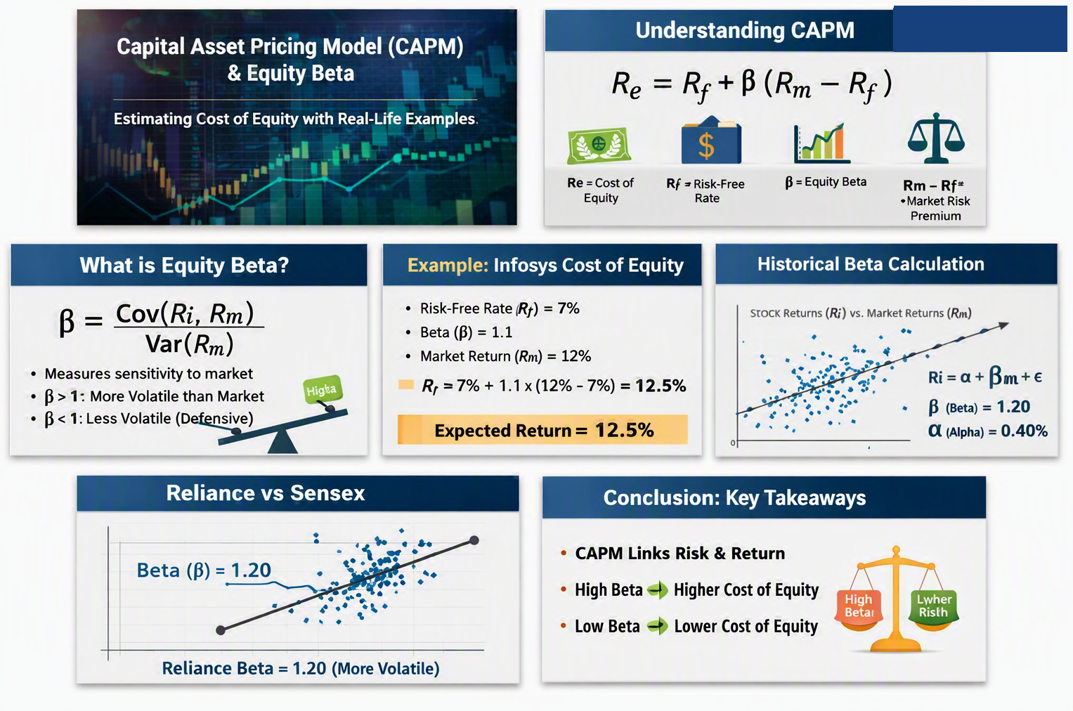
CAPM: Examples
12

Slide 14
Historical Equity Beta: Estimation
Covariance / Variance Method
Regression (Slope) Method
β = Cov(R_{i}, R_{m}) / Var(R_{m})
R_{i} = α + β × R_{m} + ε
Cov(R_{i}, R_{m}): how the stock's returns move with the market's returns
Var(R_{m}): the market's own volatility (variance)
α (alpha): stock return unrelated to the market
β (beta): the slope — systematic risk
ε (epsilon): error term — firm-specific (unsystematic) risk
13

Slide 15
Estimating Historical Betas
12
Item | Selection
Company | Reliance Industries Limited
Stock | Reliance Industries equity shares
Market benchmark | BSE Sensex
Observation frequency | Hypothetical monthly returns
Number of observations | 5

Slide 16
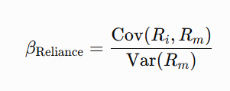
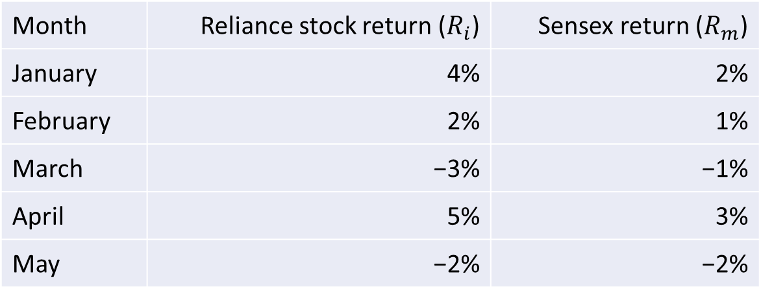
Estimating Historical Beta
12
Month | Reliance stock return ($R_{i}$) | Sensex return ($R_{m}$)
January | 4% | 2%
February | 2% | 1%
March | −3% | −1%
April | 5% | 3%
May | −2% | −2%

Slide 17
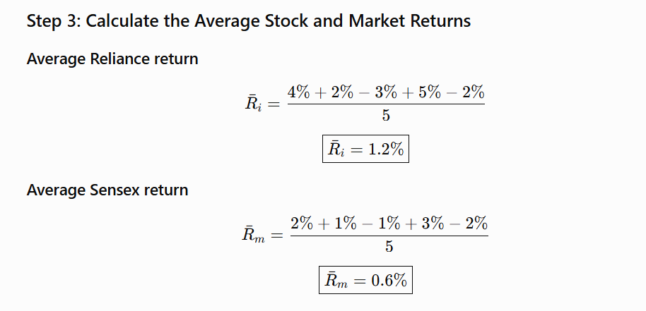
Estimating Historical Beta
Historical Equity Beta: Estimation
12

Slide 18

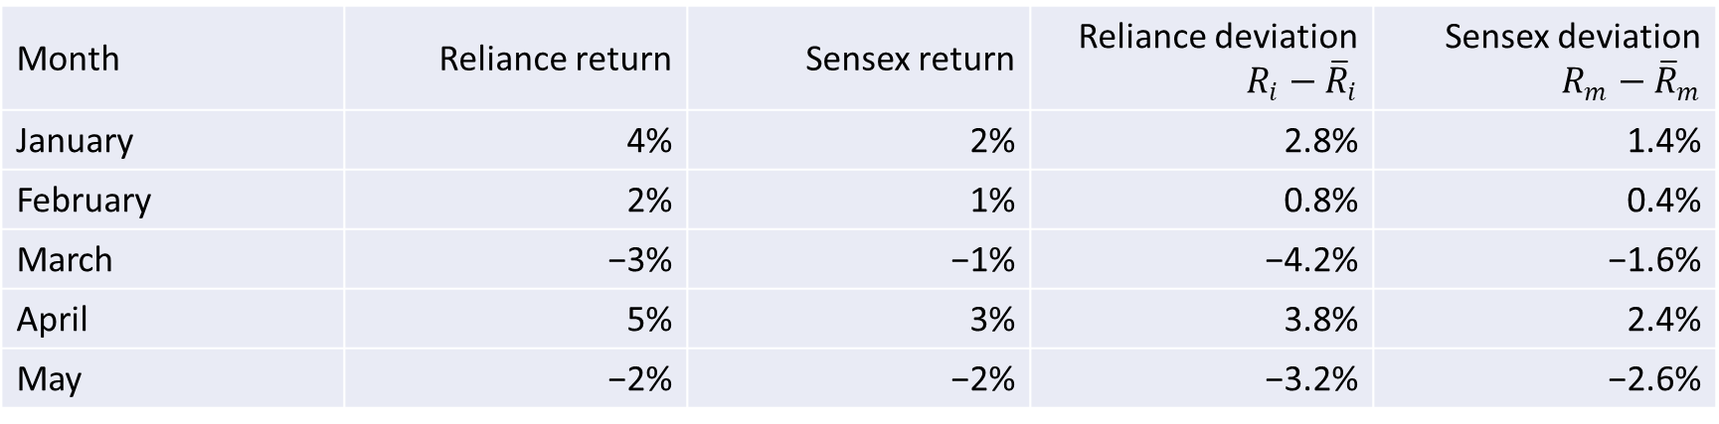
Estimating Historical Beta
Historical Equity Beta: Estimation
12
Month | Reliance return | Sensex return | Reliance deviation $R_{i}−{\overline{R}}_{i}$ | Sensex deviation $R_{m}−{\overline{R}}_{m}$
January | 4% | 2% | 2.8% | 1.4%
February | 2% | 1% | 0.8% | 0.4%
March | −3% | −1% | −4.2% | −1.6%
April | 5% | 3% | 3.8% | 2.4%
May | −2% | −2% | −3.2% | −2.6%

Slide 19
Estimating Historical Beta
Historical Equity Beta: Estimation
12
Month | Stock deviation | Market deviation | Cross-product | Squared market deviation
January | 2.8% | 1.4% | 0.000392 | 0.000196
February | 0.8% | 0.4% | 0.000032 | 0.000016
March | −4.2% | −1.6% | 0.000672 | 0.000256
April | 3.8% | 2.4% | 0.000912 | 0.000576
May | −3.2% | −2.6% | 0.000832 | 0.000676
Total |  |  | 0.002840 | 0.001720

Slide 20
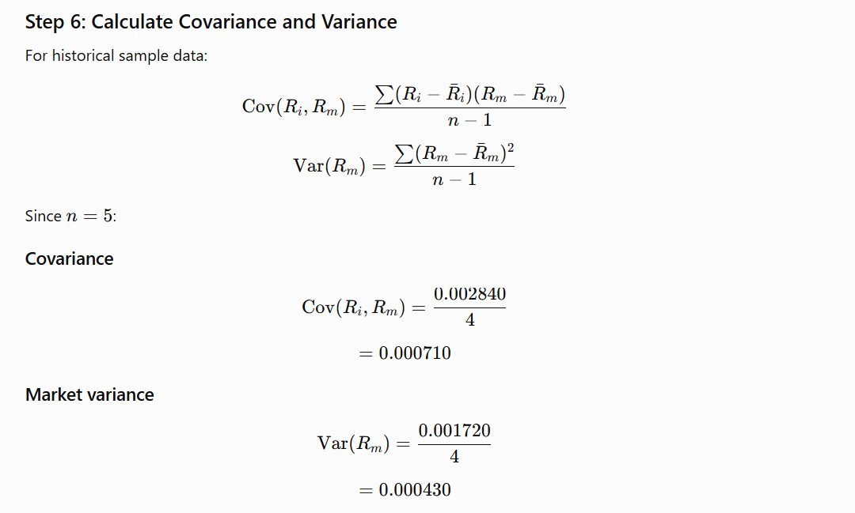
Estimating Historical Beta
Historical Equity Beta: Estimation
12

Slide 21
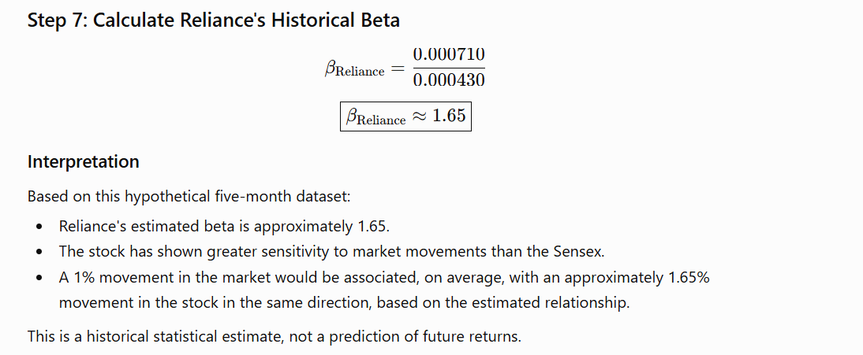
Estimating Historical Beta
Historical Equity Beta: Estimation
12

Slide 22
Cost of Equity: Examples
Two BSE Sensex stocks — India 10-yr G-Sec yield ≈ 7.0% used as Rf; assumed Rm = 13%
Reliance Industries (RELIANCE)
Tata Consultancy Services (TCS)
β = 0.83
β = 1.13
Ke = 7.0% + 0.83 × (13% − 7%)
Ke = 7.0% + 1.13 × (13% − 7%)
Ke = 11.98%
Ke = 13.78%
Less volatile than the Sensex — modest risk premium
Slightly more volatile than the Sensex — higher required return
14

Slide 23
Historical Beta: Example
Illustrative monthly returns: stock vs. BSE Sensex
Month | Stock Return Ri (%) | Sensex Return Rm (%)
1 | 2.5 | 1.8
2 | -1.2 | -0.9
3 | 3.0 | 2.2
4 | -0.5 | -0.3
5 | 1.8 | 1.5
Regression-Based Formula
β = [nΣ(RiRm) − ΣRi×ΣRm] / [nΣRm² − (ΣRm)²]
1. Find the mean of Ri and Rm
2. Compute deviations from each mean
3. Multiply deviations & sum → Covariance
4. Square (Rm deviations) & sum → Variance
5. β = Covariance / Variance
Note: Beta varies with the time period, return frequency, and benchmark index chosen — which is why different providers report different beta values for the same stock.
15

Slide 24
Stock Alpha: Meaning
Alpha measures the excess return an investment generates versus what CAPM would predict for its level of risk — it isolates skill from risk-taking.
α = R_{actual} − [Rf + β(Rm − Rf)]
α = 0
α > 0
α < 0
Performed exactly as expected for its risk
Outperformed its risk-adjusted expectation
Underperformed its risk-adjusted expectation
16

Slide 25
Alpha: Examples
Example 1 — Risk-Adjusted Comparison
Example 2 — Active vs. Passive Fund
Benchmark = 10%, Rf = 4%
Two friends invest ₹1 lakh at similar risk levels
 | Fund A | Fund B
Beta | 1.5 | 0.8
Actual Return | 14% | 12%
CAPM Expected | 13% | 8.8%
Alpha | +1.0% | +3.2%
Nifty 50 Index Fund: 20% return
Active Large-Cap Fund: 25% return
Alpha = +5%
Fund B took less risk but delivered far more excess return — more manager skill despite a lower headline return.
That extra 5% reflects the fund manager's stock selection and timing skill — the value added over simply buying the market.
17

Slide 26
CAPM vs. Dividend Growth Model
Basis | CAPM | Dividend Growth Model
Applicability | All listed companies (dividend or not) | Only dividend-paying companies
Risk measurement | Explicit — via Beta | Implicit / ignored
Data required | Rf, β, Rm | Price, expected dividend, growth rate
Key assumption | Efficient markets | Constant, perpetual dividend growth
Sensitivity | Beta & market premium estimates | Highly sensitive to growth rate (g)
Best suited for | Growth/tech & all-sector firms | Stable, mature, dividend-paying firms
18

Slide 27
Key Takeaways
Cost of capital blends cost of equity, cost of debt, and their weights (WACC)
CAPM prices only systematic (non-diversifiable) risk via Beta
Alpha reveals genuine skill — excess return beyond what risk alone explains
CAPM and the Dividend Growth Model are complementary, not competing, tools
Thank You

